Slide 1

SC1015 Mini-Project
Valencino Tan
Tan Jing Han
Ronald Tan Chang Hui

Slide 2

What is Twitch?
Twitch: American video live streaming service
Video game live streaming, including broadcasts of esports competitions
music broadcasts,
Creative content
“In Real Life" streams

Slide 3
Why we chose Twitch
Common passion for gaming
Live streaming is trending
Explore live streaming as a career

Slide 4
Problem Definition
What can help increase Twitch viewership?

Slide 5
Exploratory Data Analysis: Variables
Variables | Why we chose it
Viewer_count | What we want to predict
Total_views | Total views of all videos on channel, including after the stream has ended
Follow_count | Number of followers of user -> user’s likeability/popularity
Is_mature | Whether a stream is intended for mature audiences
Tags | Similar to hashtags, users can indicate what type of games they are playing
Language | Language of stream
Game_name | Name of game streamed
Title | Title of stream

Slide 6
Exploratory Data Analysis: Techniques
Python Script -
Twitch API
Scatter plot
Boxplot
Outliers Removal
Log function

Slide 7
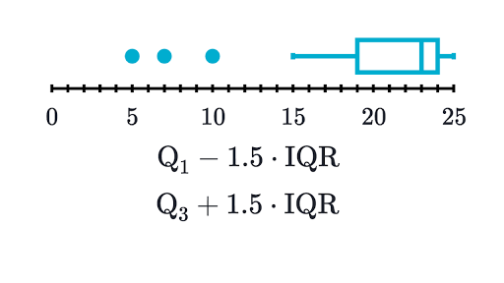
Cleaning data
1.25 * IQR
RULE
Streams without
Title
Streams without
Game Name

Slide 8

Expected challenges
Data might vary due to:
Different starting livestream times
E.g Stream had just started on the data scrape → low viewership
Twitch Raids
Transfer viewers from one stream to another
Unable to scrape the full data due to hardware and time limitations

Slide 9
Challenges for Data Collection
First Attempt → Top 100 streams
Second attempt → Top 100 every 25 pages of stream
Third Attempt → Top 25 for first 100 pages

Slide 10
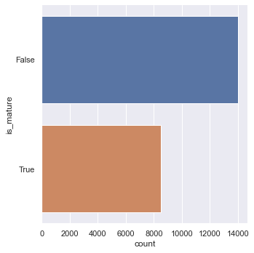
Is_mature bar plot

Slide 11
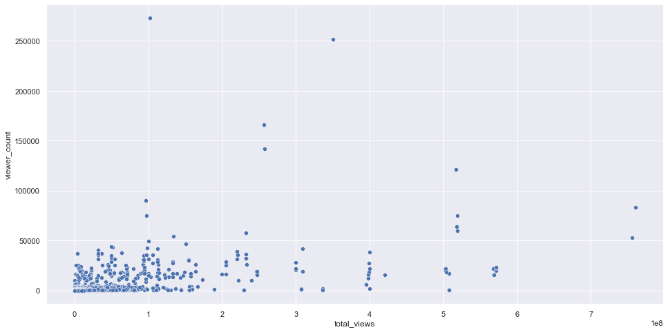
Scatter Plot: Total Views

Slide 12
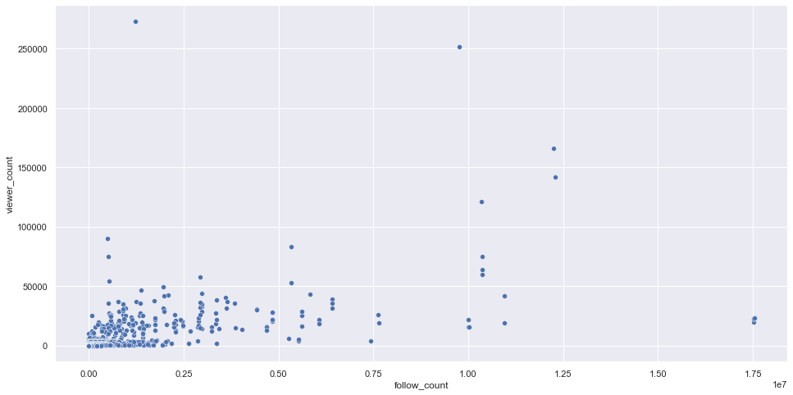
Scatter Plot: Follow Count

Slide 13
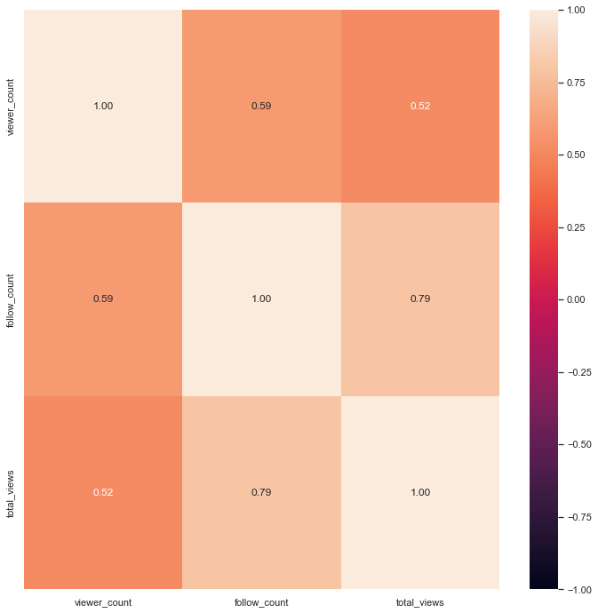
Correlation Matrix
3x3: Follow_count, Total_views, Viewer_count
Follow_count / viewer_count : 0.59
Total_views / viewer_count : 0.52
Follow_count / total_views : 0.79

Slide 14
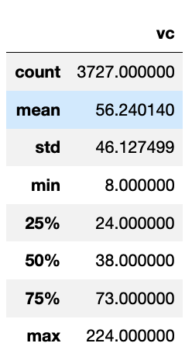
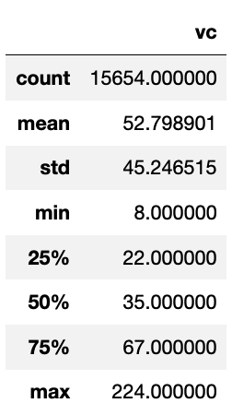
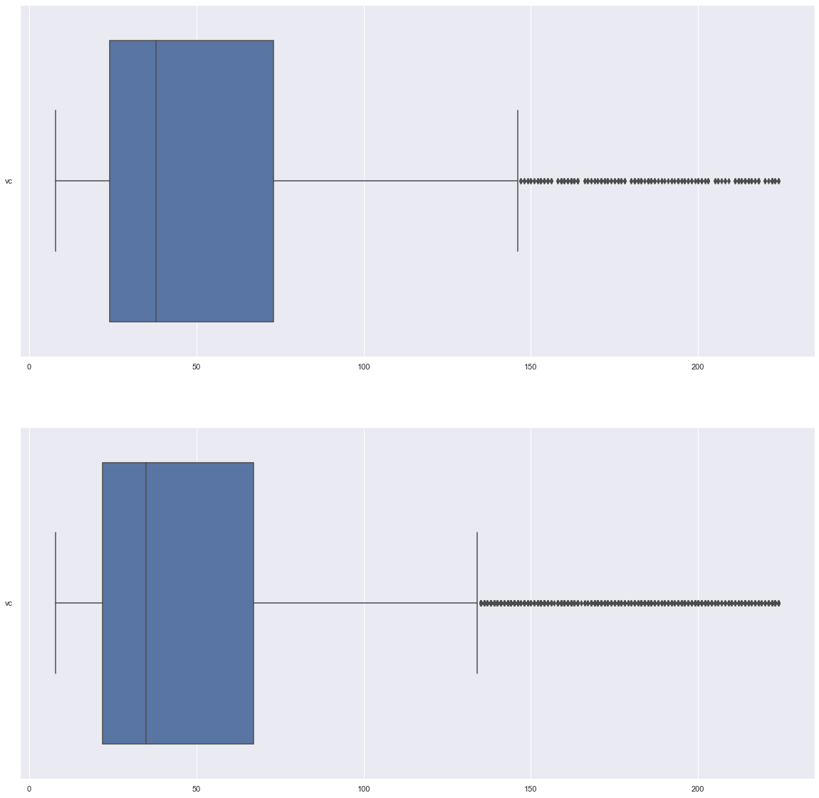
Titles and presence of emojis
With Emoji | Without Emoji

Slide 15
Models used for Data Analysis
Linear Regression
Decision Tree
Random Forest

Slide 16
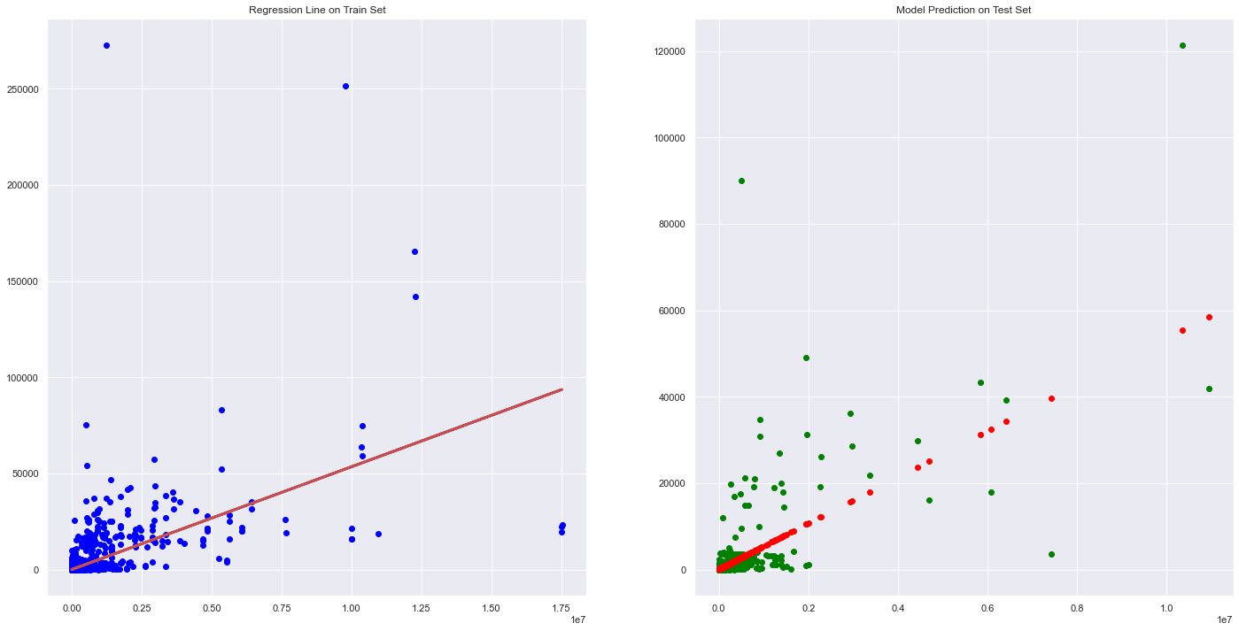
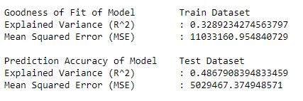
Linear Regression for “follow_count”

Slide 17
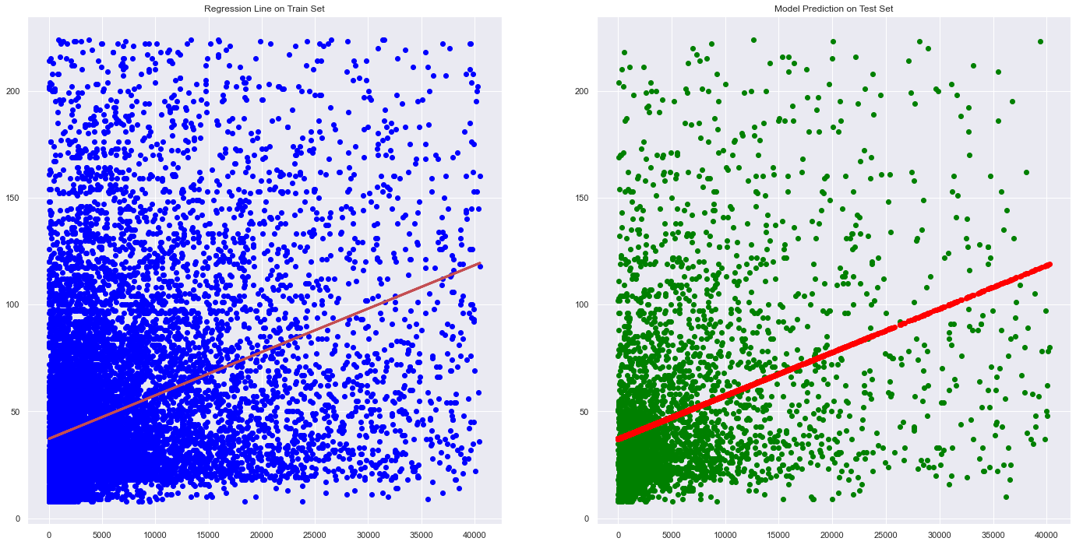
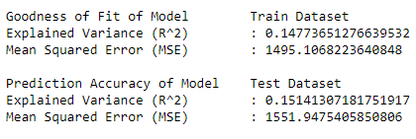
Linear Regression for cleaned data

Slide 18
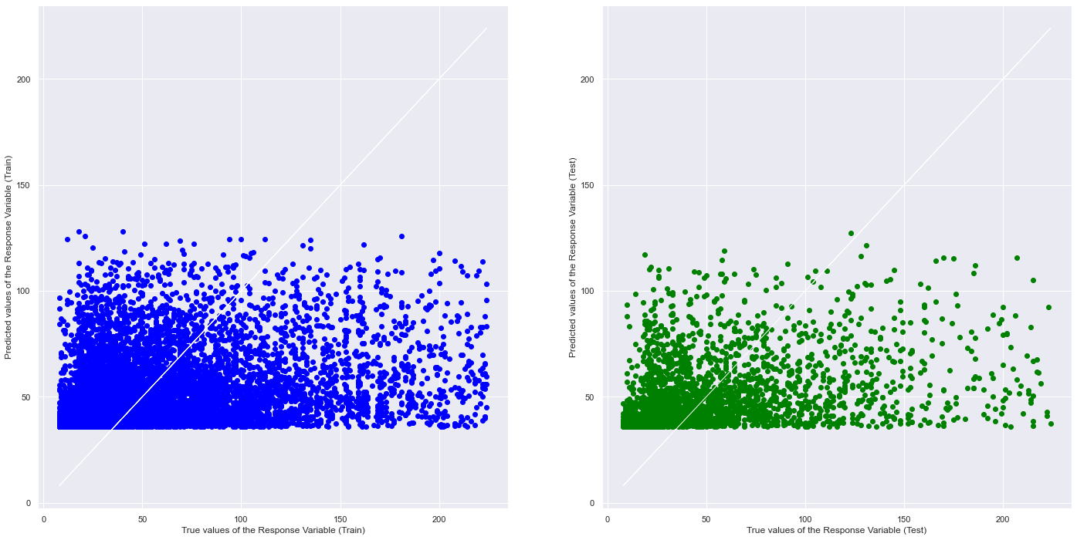
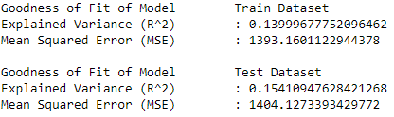
Multivariate LR

Slide 19
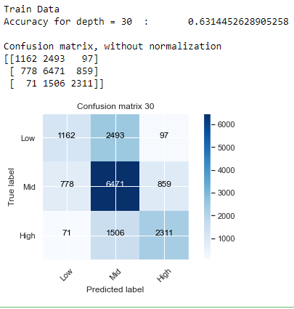
Decision Tree
We decided to try categorising active viewer count into three categories, Low, Mid and High depending on the IQR of the dataset.
Using One-Hot-encoding, we can use every numerical and categorical predictor to predict our response variable
However, the decision tree accuracy was only at 0.63.

Slide 20
Random Forest
With rForest, we played around with the values to see if there is any improvement in the accuracy levels.
Increasing depth level increased the accuracy as we had many ways to categorise the data using our predictors.

Slide 21
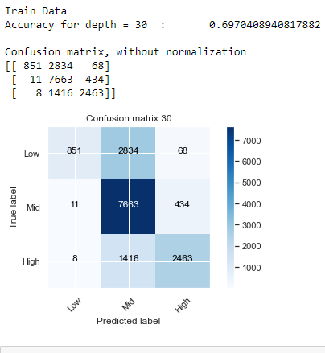
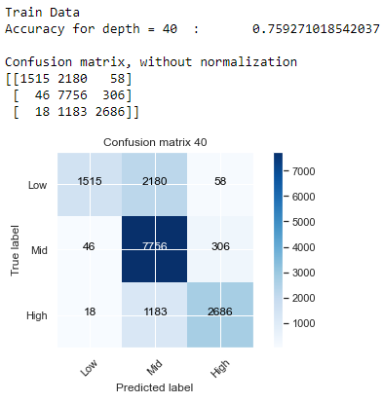
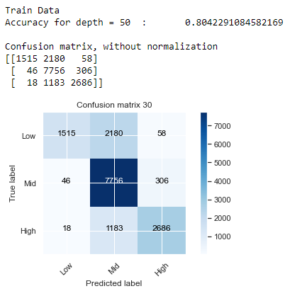
With 50 trees in the forest:
Depth = 30
Depth = 40
Depth = 50

Slide 22
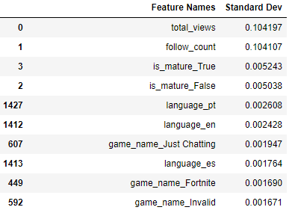
Feature Importance based on MDI
Mean Decrease Impurity (MDI) is basically how likely the data point will be mislabelled as another category
The picture shows the top 10 most important features based on the random forest machine learning algorithm
We find that total views, follow count, whether the stream is mature or not, and the language are quite important when compared to the other 1000+ predictors we have.

Slide 23
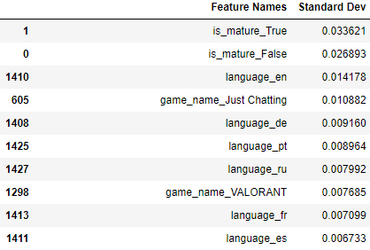
Extra: MDI without Numeric Predictors
We find that whether a stream is mature or not as well as the language is important in classifying our active viewer count group
However, the classification accuracy is only a 50% percent chance of predicting it right.

Slide 24
Outcome of data analysis
Relationship of the numeric data is not strong.
Most of the data points congregate towards the lower spectrum of Twitch.

Slide 25
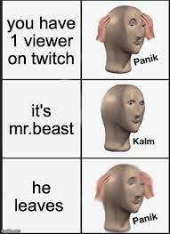
What other insights did we obtain?
Some streamers had several active viewers playing niche games. They had active viewers in the low triple digits.
Some streamers had high viewer count despite having low follower count. Possibly from Twitch raid.
Some streamers have low active viewers despite having a large community.

Slide 26
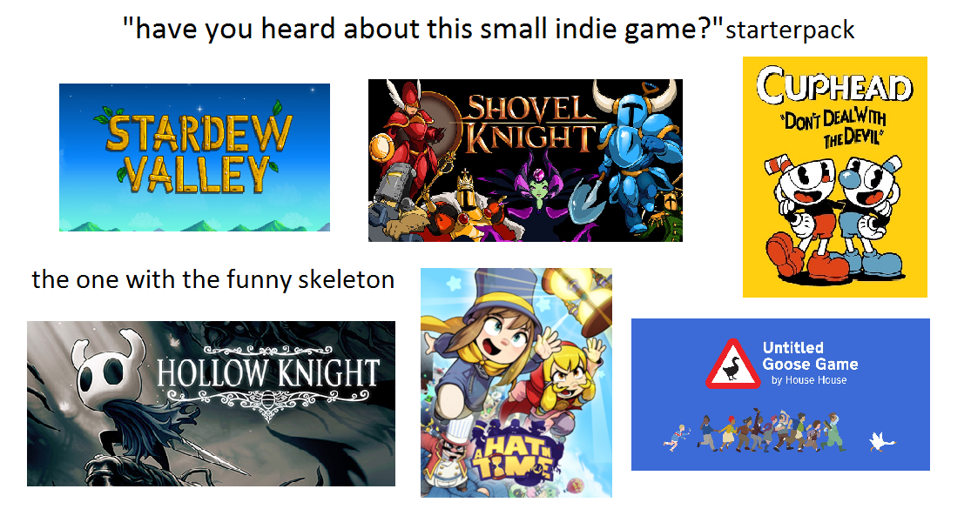
Recommendations
Streaming niche games can help to bring viewership.
Adding emojis may help to bring incremental improvement to viewership
There are significant non-English speaking audiences on Twitch, reaching out to these groups could be beneficial.

Slide 27
Thank You

